Slide 1
Developing SPAs with React and JSX/TSX
Notes:
This module introduces students to React.js and examines how React.js uses a component-based architecture and a virtual DOM to optimize performance. Students will learn to create and configure new Node.js projects as a Single Page Application (SPA) using React.js together with TypeScript and Webpack. The module walks through how to design an SPA by creating a hierarchy of React components which define properties, state and event handlers. The module introduces JSX and teaches students the essential concepts and syntax for writing TypeScript code in a TSX file to generate the HTML for a React component. Along the way, students will learn how to integrate the React Router into an SPA project to provide navigation across multiple views.

Slide 2
Agenda
Creating SPAs using React.js and TypeScript
Designing a React Component Hierarchy
Using JSX/TSX Syntax to Generate HTML
Understanding the React Component Lifecycle Methods
Calling Across the Network using the Fetch API
Extending a React Project with the React Router

Slide 3
Agenda
Overview the SharePoint Framework (SPFx)
Setting up an SPFx Development Environment
Creating Projects using the SPFx Templates
Deploying SPFx Projects using an Azure CDN

Slide 4
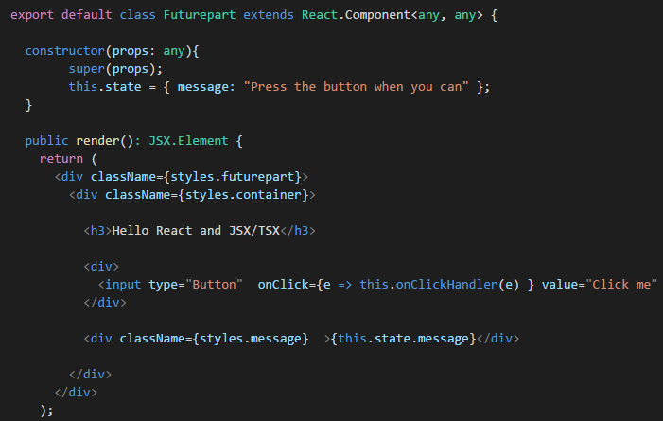
React and JSX

Slide 5
Creating Web Parts with React.js

